Slide 1
Project Progress
Development of an on-Premise AI Product Recommendation Model Using Open-Source LLM
-Monir

Slide 2
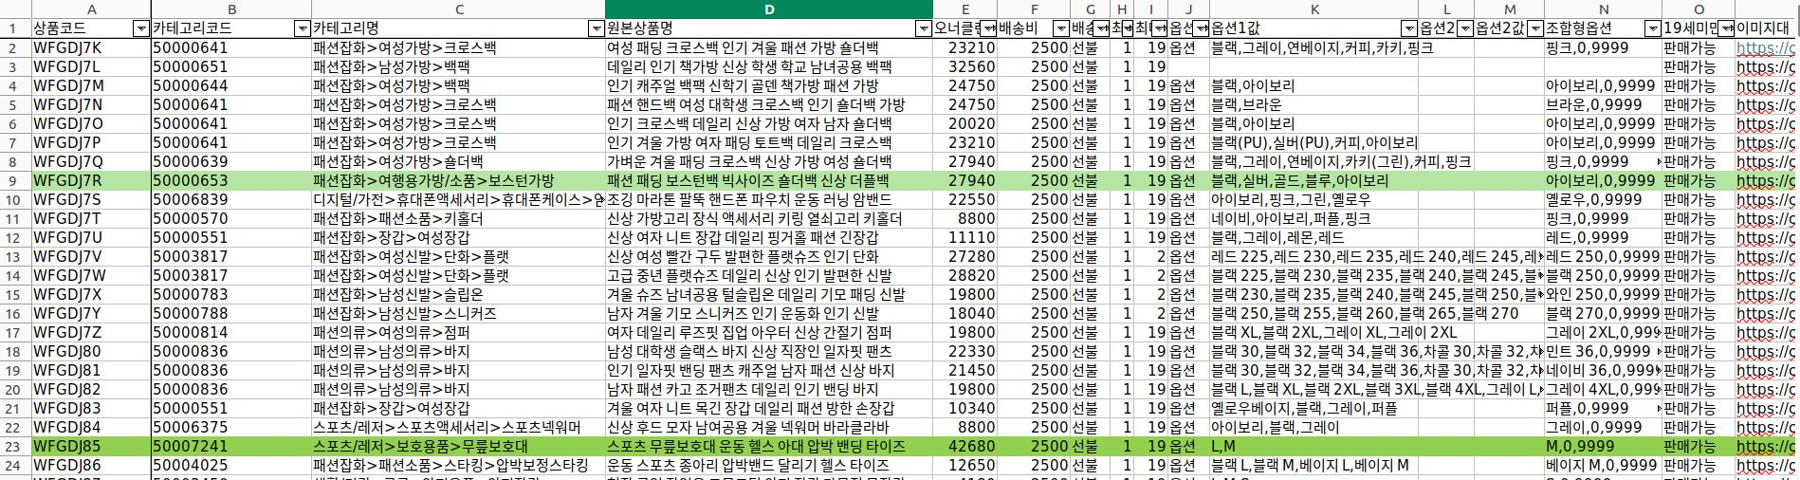
Dataset Sample

Slide 3
OwnerClan Dataset
Dataset Summary
Total Rows (Samples): 7,708
Total Columns (Features): 29
Memory Usage: 1.7 MB
Data Type Distribution:
Integer Columns: 6 (e.g., product price, stock quantity, shipping cost)
Text Columns: 23 (e.g., product name, category, keywords, descriptions)

Slide 4
OwnerClan Dataset
Dataset Features
1 "상품코드": "Product_ID",
2 "카테고리코드": "Category_Code",
3 "카테고리명": "Category_Name",
4 "원본상품명": "Product_Name",
5 "오너클랜판매가": "Price",
6 "배송비": "Shipping_Cost",
7 "배송유형": "Shipping_Type",
8 "최소구매수량": "Min_Purchase_Quantity",
9 "최대구매수량": "Max_Purchase_Quantity",
10 "옵션1명": "Option1_Name",
11 "옵션1값": "Option1_Value",
12 "옵션2명": "Option2_Name",
13 "옵션2값": "Option2_Value",
14 "조합형옵션": "Combination_Option",
15 "19세미만판매금지": "Restricted_Under_19",
16 "이미지대": "Image_Large",
17 "이미지중": "Image_Medium",
18 "이미지소": "Image_Small",
19 "제작/수입사": "Manufacturer",
20 "모델명": "Model_Name",
21 "원산지": "Country_of_Origin",
22 "키워드": "Keywords",
23 "등록일": "Registration_Date",
24 "최종수정일": "Last_Modified_Date",
25 "정보고시카테고리": "Product_Info_Category",
26 "정보고시 항목정보": "Product_Info_Details",
27 "반품배송비": "Return_Shipping_Cost",
28 "독립형": "Independent_Option",
29 "조합형": "Combined_Option"

Slide 5
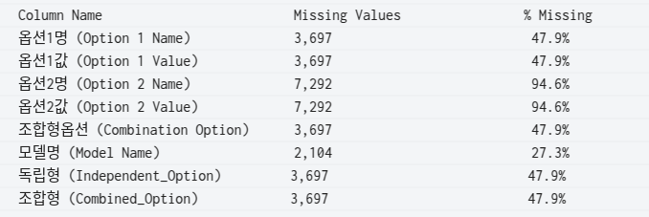
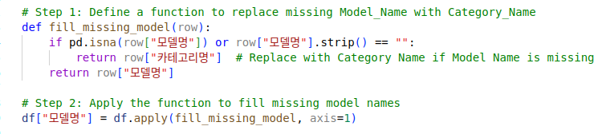
Data Pre-Processing (Data Cleaning & Formatting)
Check missing values
Write code to replace missing 모델명 (Model_Name) with 카테고리명 (Category_Name)
Check missing values : No Duplication

Slide 6
Text Embedding Generation
Convert product names, keywords, and descriptions into high-dimensional vector representations.
Initial paid model: OpenAI’s text-embedding-ada-002 model.
Free embedding model:
Sentence Transformers (all-MiniLM-L6-v2)
Hugging Face Transformers (intfloat/e5-small-v2)
Model | Best For | Vector Size | Performance
all-MiniLM-L6-v2 | Fast, lightweight product search | 384 | Best for On-Premise
intfloat/e5-small-v2 | Optimized for query-to-product retrieval | 384 | Best for Search & Recommendations
bge-small-en-v1.5 | Best for large e-commerce datasets | 384 | Best for Scaling

Slide 7
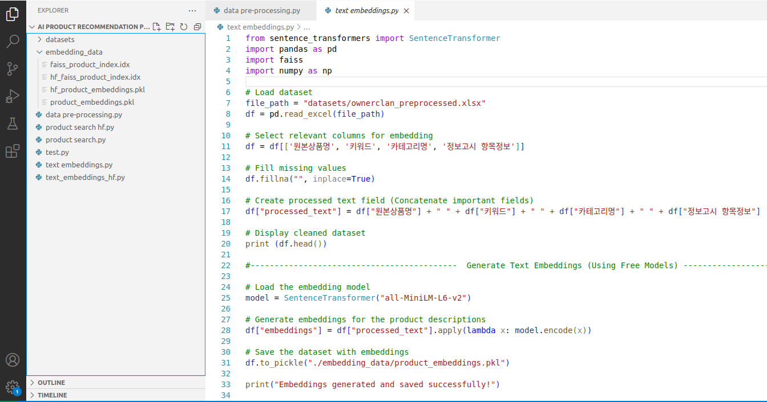
Store Embeddings in FAISS for Fast Retrieval
Faiss (Facebook AI Similarity Search) is a library that allows developers to quickly search for embeddings of multimedia documents that are similar to each other.
Stores all product embeddings efficiently.
Allows fast similarity searches.
Index is saved as faiss_product_index.idx

Slide 8
Thank You

